Slide 1
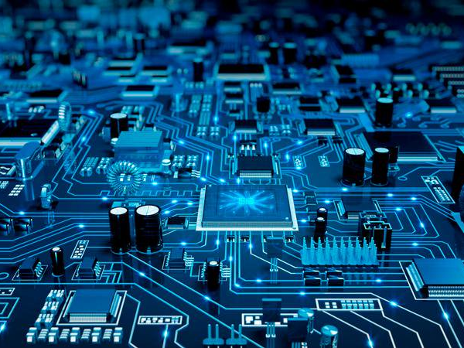
Computer Hardware

Slide 2
Module Aims & Objectives
To develop the fundamental skills required in installation, configuration, maintenance and
management of personal computer systems and simple data communication devices in a
general office environment

Slide 3
Introduction to Computer System and its Classifications

Slide 4
Versatile electronic device, which is programmable and process data according to a given set of instructions
Definition of a Computer

Slide 5
Speed
Accuracy
Storage
Diligence
Versatility
Memory / Power of Memory
Reliability
Characteristics of a Computer

Slide 6
Characteristics of a Computer
Speed
no human being can compete to solving the complex computation, faster than computer.
Giga Hertz (GHz) – Billion clock cycles per second
– Eg: 800MHz – 1 instruction in 0.00000000125 second
Accuracy
Since Computer is programmed, so what ever input we give it gives result with accurately
Storage
Computer can store mass storage of data with appropriate format

Slide 7
Characteristics of a Computer
Diligence
Computer can work for hours without any break and creating error
Versatality
We can use computer to perform completely different type of work at the same time.
Reliability
Computer is reliable than a Human especially in repetitive tasks

Slide 8
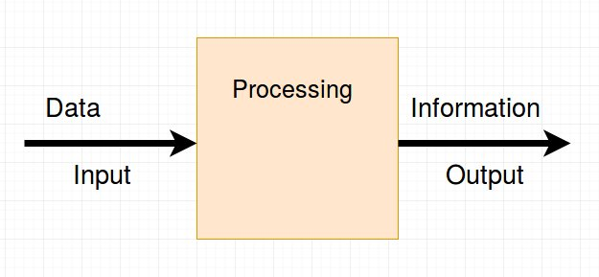
Data Processing

Slide 9
Data
  Data is raw facts
  Meaningless
  Collection of numbers, characters, symbols
Information
  Processed data
  Meaningful
  Can be used for decision making
  Valuable than data
Data Vs Information

Slide 10
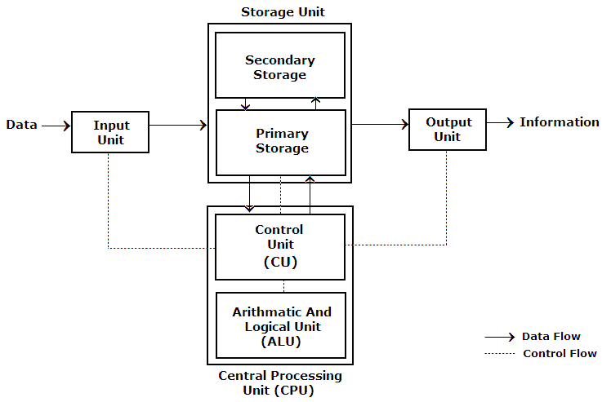
Block Diagram of a Computer

Slide 11
Primary Memory
Primary memory is computer memory that a processor or computer accesses first or directly.
Examples:
  RAM, Cache, Registers
Primary memory is volatile
Primary memory is faster than Secondary Memory

Slide 12
Secondary Memory
Secondary memory is where programs and data are kept on a long-term basis.
Common secondary storage devices are the hard disk and optical disks.

Slide 13
Control unit handles the all operations of processor by sending control signal to devices.
Control Unit

Slide 14
ALU
Arithmetic and Logical Operations are performed by the ALU.
ALU stands for (Arithmetic and Logic Unit)
Arithmatic Operations:
  Addition, substraction, division and multiplication
Logical Operations:
  And, or, not , greater than and lower than operations

Slide 15
Majour device types in a computer
Input Devices
Output Devices
Processing Devices
Storage Devices
Networking Devices

Slide 16
Devices which is capable of input data to the computer are called “Input Devices”
Input Devices

Slide 17
Devices which are capable of output the processed data to the user are called “Output Devices”
Output Devices

Slide 18
Keyboard
Mouse
Scanner
Camera
Microphone
Finger print scanner
Track ball
Light pen
Optical Character Recognition (OCR)
Bar code reader
Input Devices

Slide 19
Monitor
Printer
Plotter
Speaker
Output Devices

